Slide 1
Credit Card Fraud Detection using XGBoost and CatBoost
Machine Learning Based Fraud Detection System
Domain: Banking & Financial Security
Dataset: Credit Card Transaction Data
Prepared by: Prashant Kumar
Department: Computer Science & Engineering

Slide 2
Introduction
Growth of digital payments has increased fraud risks
Credit card fraud causes financial losses and customer dissatisfaction
Traditional systems fail to detect complex fraud patterns
Machine learning enables accurate and automated fraud detection
Objective:
To detect fraudulent transactions using advanced boosting algorithms.

Slide 3
Problem Statement
Fraud detection is a binary classification problem
Transactions are classified as:
Legitimate (0)
Fraudulent (1)
Major challenges:
Highly imbalanced dataset
Complex and evolving fraud patterns
Need for high recall and precision

Slide 4
Dataset Description
Dataset contains anonymized credit card transactions
Features are numerical and privacy-protected
Target variable:
  Class = 0 → Normal transaction
  Class = 1 → Fraudulent transaction
Observation:
Fraud cases form a very small portion of the dataset.

Slide 5
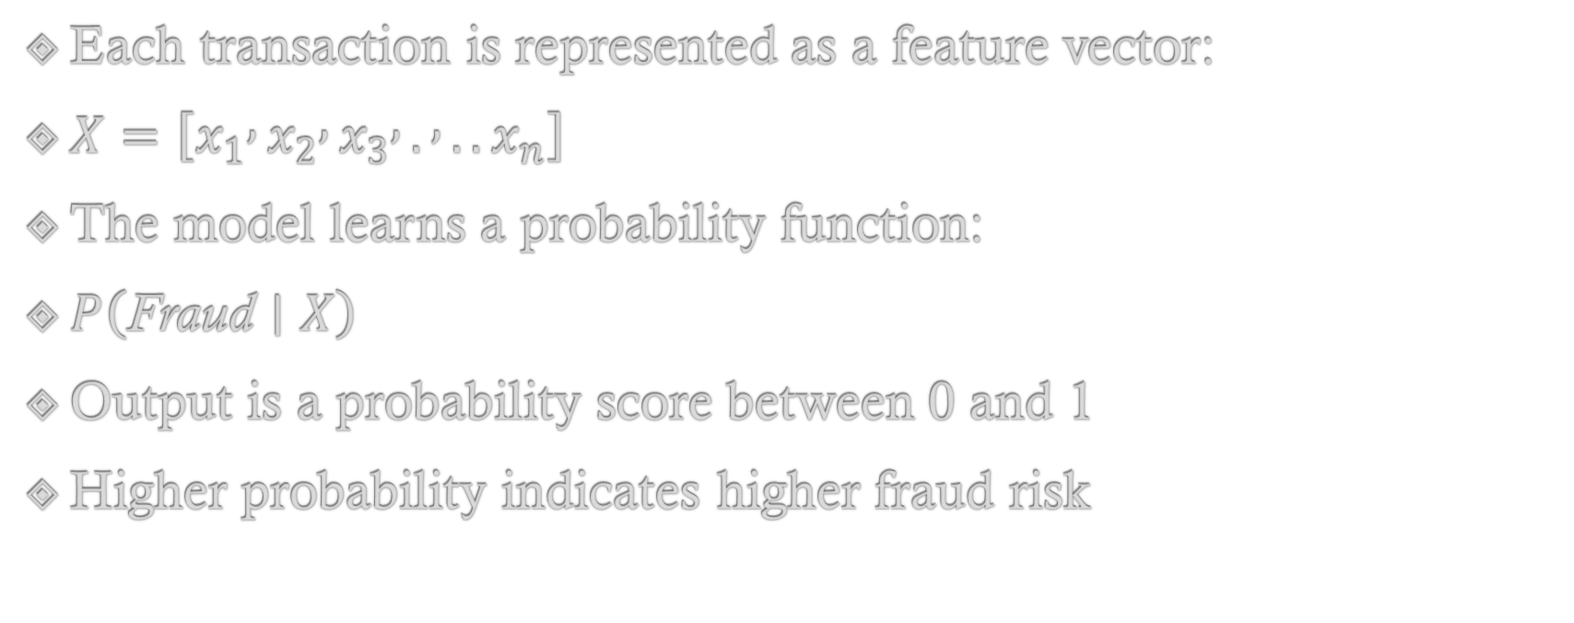
Mathematical Intuition
Each transaction is represented as a feature vector:
$X=\left[x_{1} , x_{2} , x_{3} , . , ..x_{n}\right]$
The model learns a probability function:
$P\left(\text{Fraud}∣X\right)$
Output is a probability score between 0 and 1
Higher probability indicates higher fraud risk

Slide 6
XGBoost Classifier
Extreme Gradient Boosting algorithm
Builds trees sequentially to minimize prediction error
Uses regularization to avoid overfitting
Advantages:
High accuracy and efficiency
Handles large and complex datasets
Widely used in financial institutions

Slide 7
CatBoost Classifier
Gradient boosting algorithm developed by Yandex
Handles categorical features effectively
Uses ordered boosting to reduce prediction bias
Advantages:
High performance with minimal preprocessing
Robust against overfitting
Stable and reliable predictions

Slide 8
Model Training & Evaluation
Dataset split into training and testing sets
Models trained:
  XGBoost
  CatBoost
Evaluation metrics:
  Precision
  Recall
  F1-score
  ROC–AUC
Focus:
Detecting rare fraudulent transactions accurately.

Slide 9
Results & Comparison
XGBoost:
  Excellent predictive performance
  Strong generalization ability
CatBoost:
  Consistent and stable predictions
  Reduced overfitting risk
Both models effectively identify fraudulent transactions.

Slide 10
Conclusion & Future Scope
Conclusion:
Boosting algorithms are highly effective for fraud detection
XGBoost and CatBoost complement each other
System is suitable for real-world financial applications
Future Scope:
Real-time fraud monitoring
Explainable AI integration
Deployment using web or cloud platforms

